Slide 1
CROWD COUNTING AND MONITORING FOR SURVEILLANCE VIDEOS

Slide 2
CONTENTS
Abstract
Introduction
Existing System
Literature Survey
Methodology
Dataset and Evaluation Measures
Software and Hardware requirements
Data flow diagram
Objective of proposed system
Scope of proposed system
Conclusion

Slide 3
ABSTRACT
A Crowd is a gathering of number of people at some place. It is not feasible to count/monitor all the people at various places like university, shopping malls by looking at them. The complexity of monitoring, tracking and counting increases as the size of the crowd increases. We can’t monitor the crowd for suspicious behaviour as well. However, with the introduction of Closed Circuit television(CCTV) camera this problem been solved up to some extent. But still we are not able to track/monitor a large group of people with CCTV. The tough task is that it is not feasible for human operator to sit all the time in front of the CCTV and monitor/count the crowd. There is a need of an automated system and detecting objects from CCTV surveillance video can solve many real-life problems.
Localisation based method divide an image into a number of sub regions and then apply regression-based counting techniques locally. In sparse crowd it is appropriate to use individual pedestrian detection. These approaches are best suited for sparse environment in which the detected object is fully visible. This approach attempts to explain the observed image features by estimating the approximate spatial arrangement of pedestrian in the scene.
To count the people from crowd video, a Convolutional Neural Networks(CNN) based model will be developed. The model will have convolution layer, RELU and max pooling layer, fully convolutional layer and soft max activation function. Firstly, individual frames will be extracted from video and passed as input to convolution layer. A convolution of appropriate size(M x N) will be applied on input image to extract the features and create a feature map. The model will be trained by some sample training data and then it will be tested by some test data. The feature extraction will be performed automatically by the model. When training and testing part is over, new input video will be applied and output of the model will be matched with ground truth values. Depending on the accuracy of the result more number of layers will be added or model will be trained against more number of epochs. Measure such as accuracy. Mean Absolute Error (MAE) and Mean Squared Error (MSE) will be computed by comparing the counted results and ground truth values from the datasets.

Slide 4
INTRODUCTION
Despite the challenges, crowd counting and monitoring remains an active research area in computer vision in recent years.
Numerous approaches have been proposed over the years. It has an obvious extension to surveillance applications due to potential for improving safety systems
Earlier computer systems were rule based but with the introduction of machine learning, now machines can learn from the data and can act accordingly.
Deep learning is the sub fields of machine learning. A lot of research is going on in object and People recognition from image and video.

Slide 5
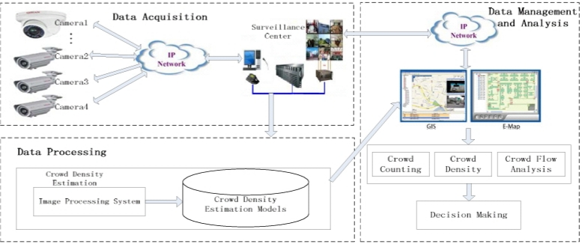

Slide 6
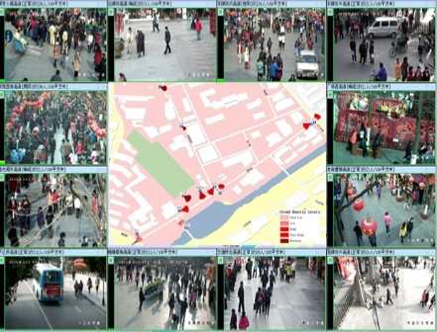
EXISTING SYSTEM
Most of the methods of the crowd counting can be grouped into three categories:
Detection-based
Global regression
Density estimation

Slide 7
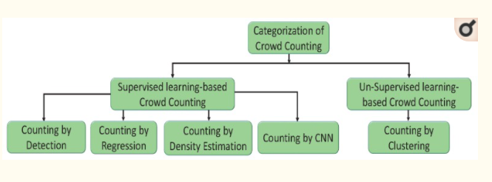

Slide 8
LITERATURE SURVEY
The earlier literature, Lin and Davis and Wang proposed a detection-based method, which uses two consecutive video frame sequences.
The detection-based methods perform better in relatively low dense scenes, while they are limited by the heavy occlusion in dense crowds.
To overcome the difficulties of detection-based methods Chan and Vasconcelos and Ryan et al proposed a regression-based method that predicts the number of people
These methods are challenging to handle dense scenes or the image severely disturbed by the background.
Finally, density estimation based methods introduced. These methods demonstrate good performance on crowd counting.

Slide 9
METHODOLOGY
Step 1: Data collection and dataset preparation
This will involve collection of publicly available video
datasets from available sources. There are many publicly available
datasets like UCSD pedestrian dataset, Grand Central railway
station datasets etc.
Step 2:Developing a CNN based crowd counting and
monitoring model
Step 3:Training and experimentation on datasets

Slide 10
Visual Geometry Group(Vgg16)
To count the people from crowd video, a CNN based model will be developed. The model will have convolution layer
The main aim of the proposed work is to provide an end to end application for crowd counting through surveillance video feeds
The Deep Convolution Neural Network (DCNN) used for crowd counting is based on Dilated Convolutional Neural Networks(CSRNet)
Many crowd counting research work employ the use of Very Deep Convolutional Neural Network (VGG 16)
Firstly, individual frames will be extracted from the video and passed as input to the convolution layer.
A convolution of appropriate size (M x N) will be applied on input image to extract the features and create a feature map.
The fully-connected layers of VGG-16 are removed along with 2 pooling layers to play down the negative effects of pooling operation on output accuracy

Slide 11
Monitoring
We make the threshold value for a particular places
If the threshold value is less than crowd count at that particular place
It should display a alert message that crowd limit exceeded.
Its all done by monitoring the given video as input.

Slide 12
DATASET AND EVALUATION MEASURES
The UCSD pedestrain dataset contains 2000 frames of a single scene. The video in this dataset is recorded at 10 fps with the frame size of 158x238.
Grand Central railway station dataset contain 50010 frames, Frame Rate:25 fps at 720x480.
Measures such as accuracy, Mean Absolute Error (MAE) and Mean Squared Error (MSE) will be computed by comparing the counted result and ground truth values from the datasets.

Slide 13
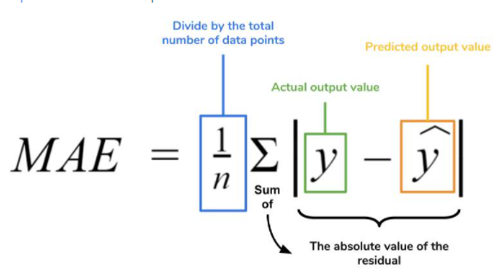
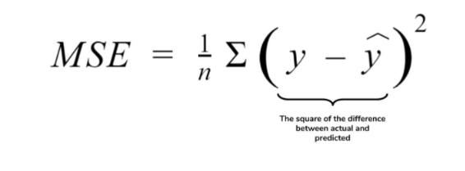


Slide 14
SOFTWARE AND HARDWARE REQUREMENTS
For implementation and experimentation of the project, python based Computer Vision and Deep Learning libraries will be exploited.
Specifically, libraries such as OpenCV, Keras, TensorFlow, YOLO will be used.
Training will be conducted on NVIDIA GPUs for training and Jupyter /Google Colabs are used for the end-to-end version of CNN based crowd counting model.

Slide 15
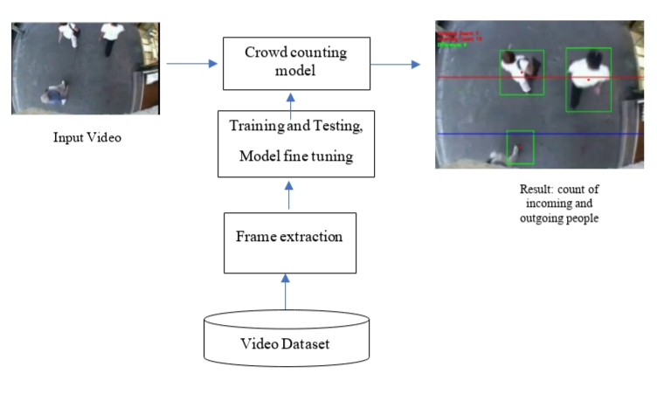
ARCHITECHTURE

Slide 16
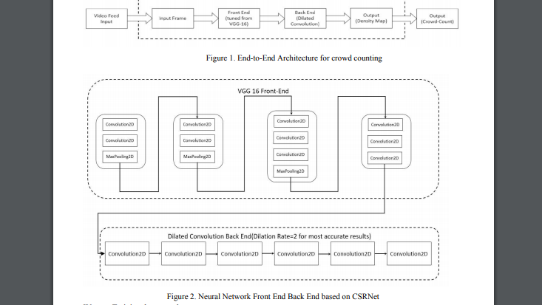

Slide 17
OBJECTIVE
Easily handle large-scale variation in people’s size when
appearing in images.
Facilitate to generate local density maps within a crowd
scene.
Decreases the MSE and MAE by CNN technique.

Slide 18
SCOPE
It is mainly used in real-life for automated public Count
It is also used for surveillance of Suspicious activities
The proposed system architecture can also be used in monitoring real time traffic by creating density maps for cars.
Similar to object detection, crowd counting aims at recognizing arbitrarily sized targets in various situations.

Slide 19
CONCLUSION
We implement the real-time monitoring and spatial-temporal analysis for crowd density based on this video surveillance .
If the monitoring area has a large number of cameras, we would have to do work to obtain the cameras crowd counting estimation model.
CNN based techniques can effectively support many applications that requires adaptive monitoring, identification, and management over diverse crowd-gathering horizons.
So we should further study the crowd counting estimation model’s flexibility, reliability, accuracy, efficiency and their versatility.

Slide 20


Slide 21


